Slide 1
Sign offs in Ktern Application

Slide 2
What is sign off?
Sign offs is a procedure of reviewing and approving things such as policies, documents or a level of software life cycle etc…
In simple words, it’s a formal way of closing a project.

Slide 3
Steps in sign off
01
02
03
04
05
Creation of sign off
Sign off initiation
Review or Approval
Re- submission
Approval

Slide 4
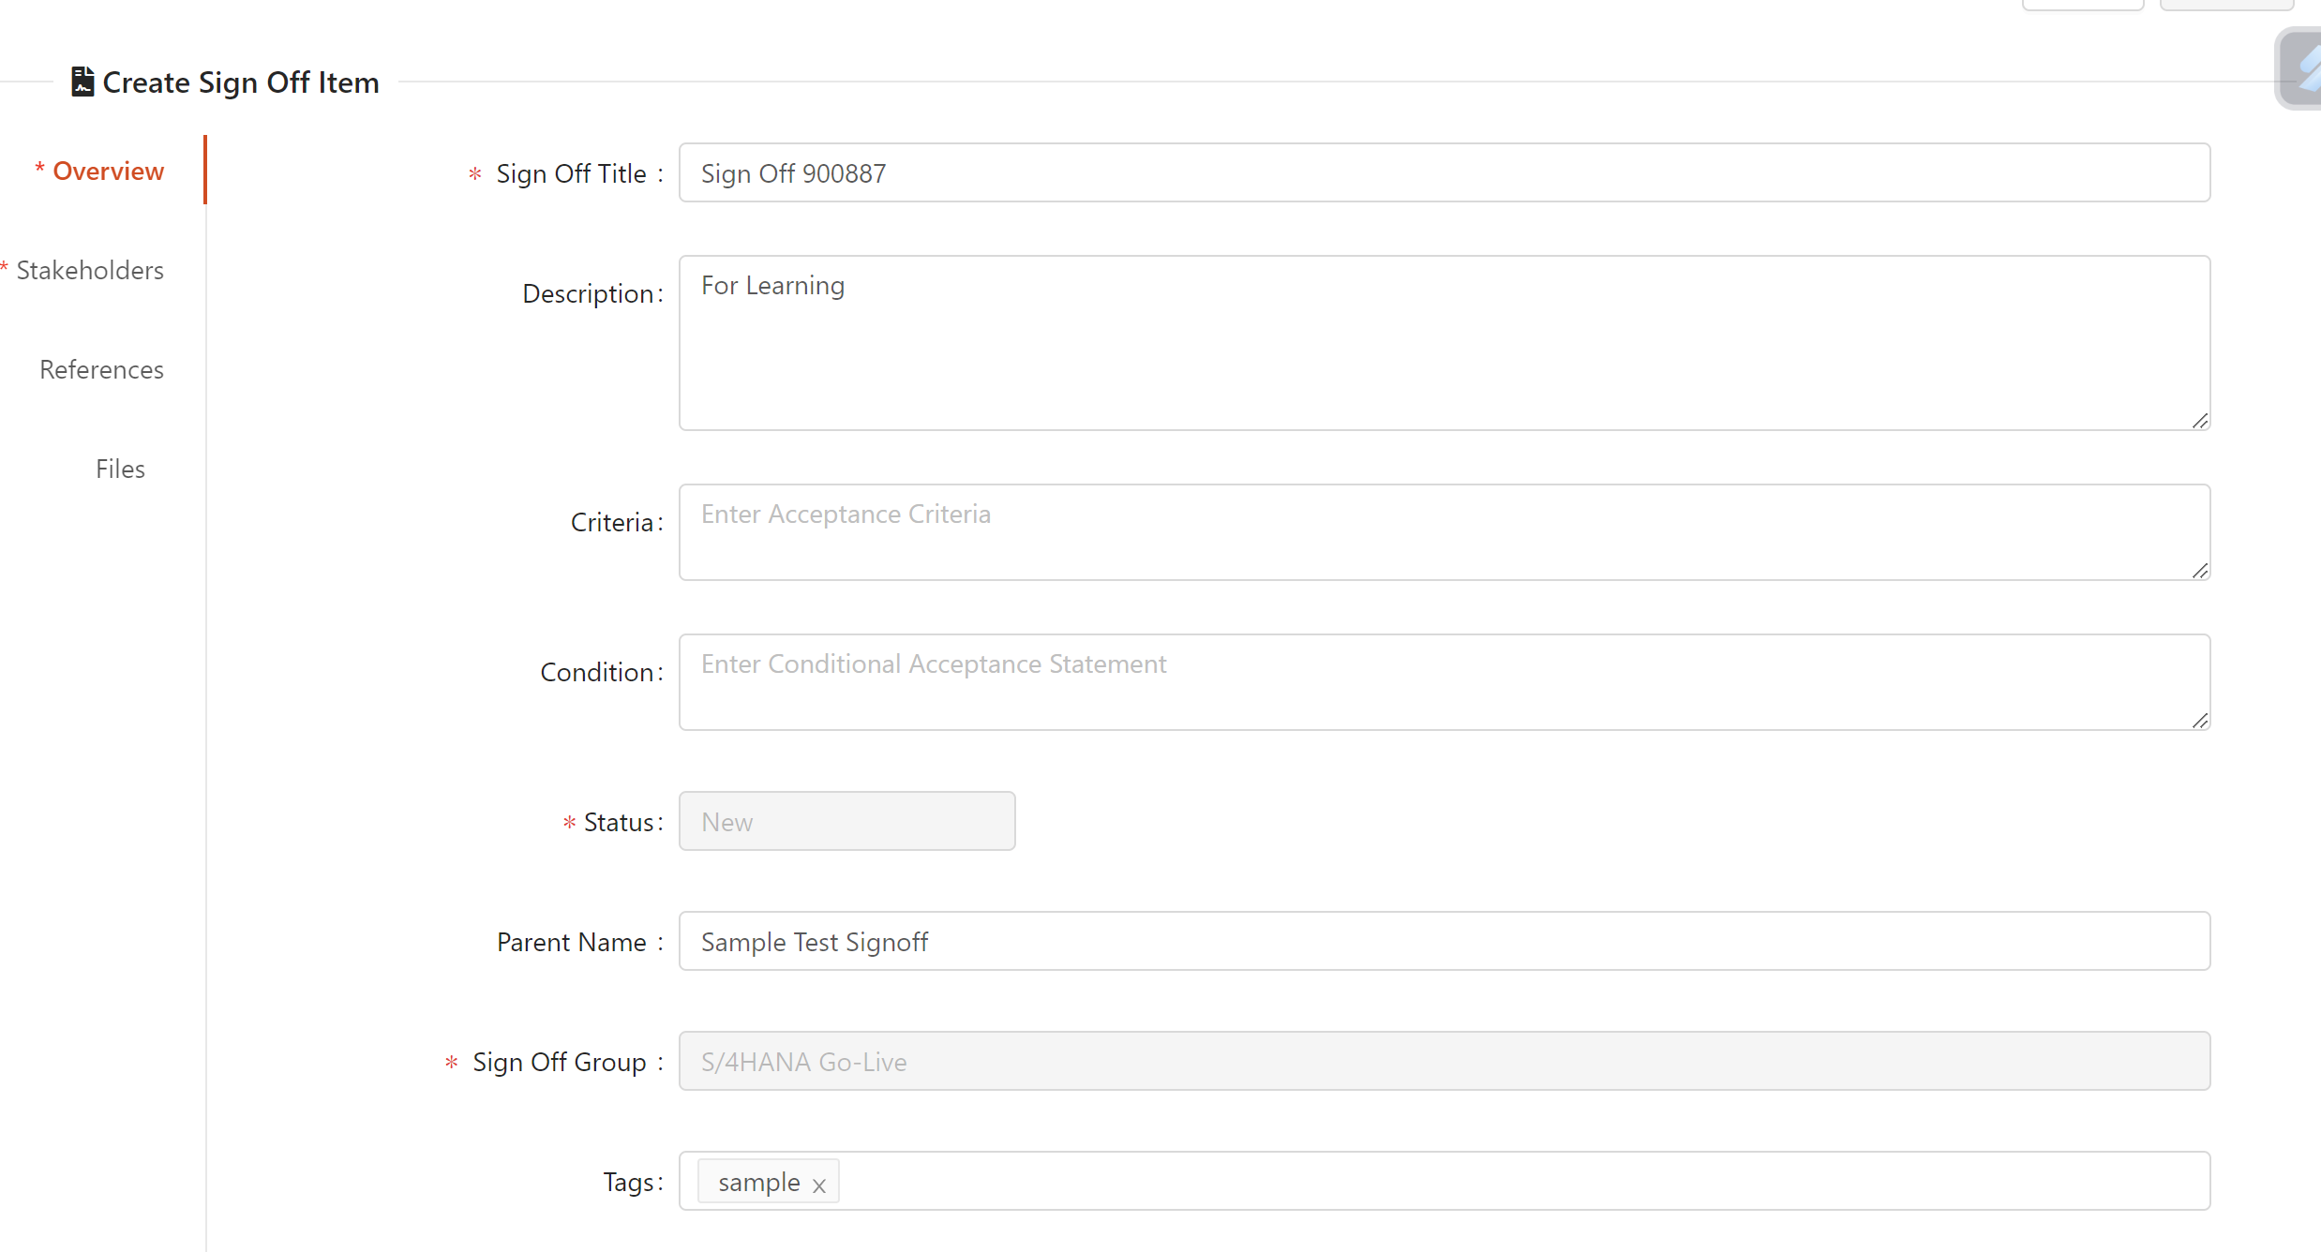
Creating sign off
To create a sign off , we need a sign off group.

Slide 5
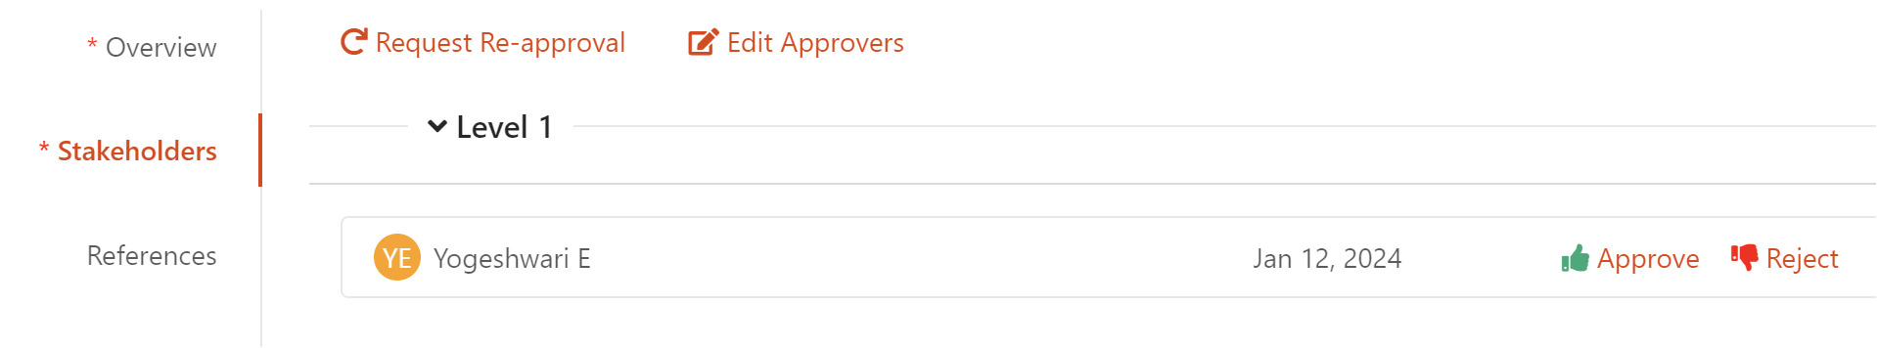
2. Stakeholder assignment
3. We can download the sign off we have created for reference.
Sign Off 900887.docx

Slide 6
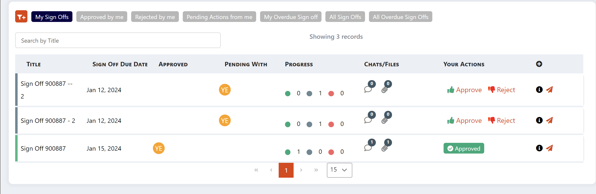
Sign offs created.

Slide 7
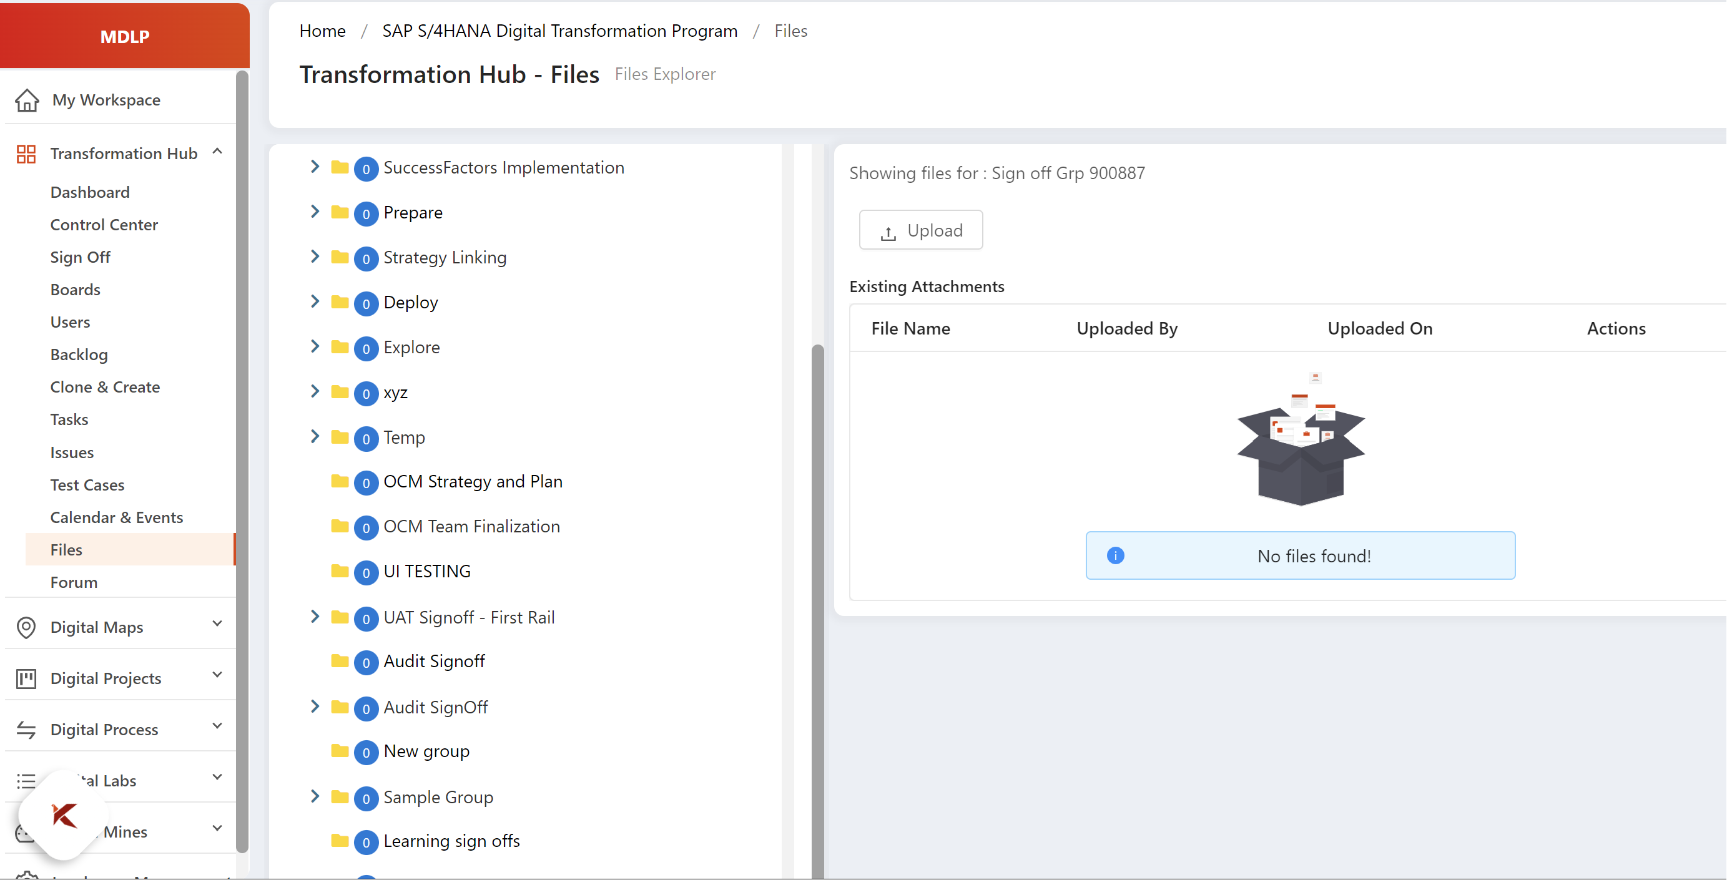
The files uploaded in sign offs could be viewed in transformation hub -> files

Slide 8
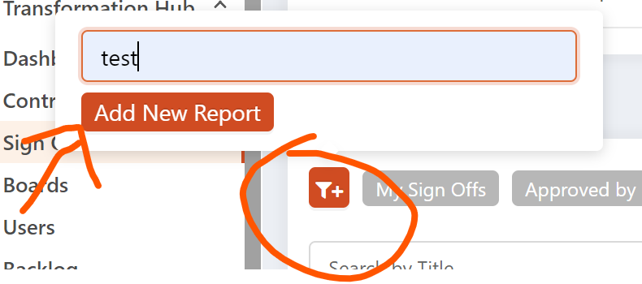
We can have our own reports by selecting appropriate filtering.

